Slide 1

3D Print Floral Design
Presented by
Macy Varga & Vedi Vartani

Slide 2
Index
ECE 425
INTRODUCTION
CODE
3D Floral Design
DESIGN
RESULTS
#1
02
08
15
20

Slide 3

ECE425
3D Floral Design
INTRODUCTION
#2

Slide 4
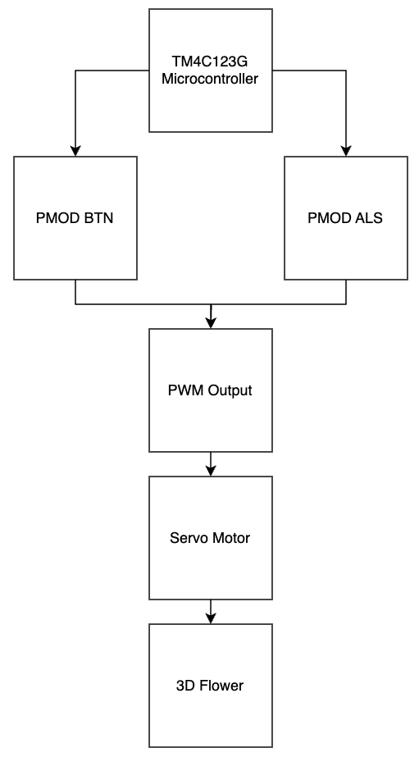
ECE425
3D Floral Design
#3
A 3D-printed flower that realistically blooms using servo-driven vertical petal motion. Initially button-controlled, it evolves to respond to ambient light via a sensor. A TM4C123 microcontroller manages smooth, precise movement through PWM control. The system demonstrates key ECE 425 embedded concepts such as GPIO, interrupts, SPI, and PWM, blending mechanical design with autonomous behavior.

Slide 5
Background and Methodology
System Architecture Overview
ECE425
3D Floral Design
#4
OBJECTIVE
KEY CONCEPTS
Implement a blooming 3D flower using embedded systems
GPIO input for button pressed
SPI communication
PWM output to control a servo motor
Interrupt-driven and autonomous operation

Slide 6
Background and Methodology
Manual & Automatic Modes
ECE425
3D Floral Design
#5
MANUAL MODE
AUTOMATIC MODE
Uses PMOD BTN module (PA-PA5)
Rising-edge GPIO interrupts handle button presses
Each button adjusts the servo via PWM
Uses PMOD ALS light sense via SPI (PB4, PB5, PB6)
Light intensity triggers blooming when above threshold
Periodic polling every 300ms

Slide 7
Background and Methodology
Motion Control & Timing
ECE425
3D Floral Design
#6
SERVO MOTOR
HS-485HB
TIMING
Controlled with 50Hz PWM on PF2
Duty cycle maps to bloom position (closed ~1875 ticks, open ~3590 ticks)
SysTick timer configured for 1μs resolution
Used for precise delays in sensor polling and motion control

Slide 8
Background and Methodology
Integration & Challenges
ECE425
3D Floral Design
#7
INTEGRATION
CHALLENGES
GPIO & Interrupts for button input
SPI for light sensing
PWM for motor control
Unified under TM4C123 microcontroller
Mechanical transition from rotary to linear motion
3D print limitations and external fabrication delays

Slide 9

ECE425
3D Floral Design
CODE
#8

Slide 10
Analysis
ECE425
3D Floral Design
#9
Main Logic (main.c)
Central control for both manual (button) and automatic (light sensor) modes
Mode selected via macros
#define USE_PMOD_BTN –> manual
#define USE_PMOD_ALS –> automatic
Only one mode can be active at a time to avoid conflicts
Module Initialization
SysTick_Delay_Init() - microsecond timing
PWM1_3_Init() - 50Hz PWM on PF2, starts at closed position (1875 ticks)
EduBase_LEDs_Init() - visual feedback

Slide 11
Analysis
ECE425
3D Floral Design
#10
MANUAL MODE (button control)
Interrupt-Driven Input
PMOD BTN (PA2-PA5)
PMOD_BTN_Interrupt_Init() sets up GPIO interrupts
Rising-edge interrupts trigger PMOD_BTN_Handler()
Servo Control
BTN0 → Close flower
BTN1 → Bloom flower
Duty cycle adjusted via PWM1_3_SetDuty()
Main Loop
Stay idle; all control handled via interrupts

Slide 12
Analysis
ECE425
3D Floral Design
#11
AUTOMATIC MODE (light sensor)
Light-Based Control
Poll PMOD_ALS_Read() every 300ms
Light > 100 → open flower
Light < 100 → keep closed
EduBase LEDs show top 4 bits of light value
SPI Setup
SSI2_Init() configures PB4 (SCLK), PB5 (CS), PB6 (MISO)
Timing
Uses SysTick_Delay1ms() and SysTick_Delay1us() for stability

Slide 13
Analysis
ECE425
3D Floral Design
#12
Code Organization and Execution
Modular Design
PWM1_3.c → PWM control
SysTick_Delay.c → Timing
GPIO.c → LED & button utilities
PMOD_BTN_Interrupts.c & SSI2.c → peripheral handling
Execution
Select mode via macro in main.c
Compile with Keil uVision
Flash to TM4C123G LaunchPad
Interact via button or light to trigger blooming
Takeaway
Practical application of GPIO interrupts, SPI communication, and PWM- all tied to real world mechanical motion.

Slide 14
Components Used
Software Used
ECE425
3D Floral Design
#13
Description | Quantity | Manufacturer
Tiva C Series TM4C123G LaunchPad | 1 | Texas Instruments
USB-A to Micro-USB Cable | 1 | N/A
EduBase Board | 1 | Trainer4Edu
PMOD ALS (Ambient Light Sensor) | 1 | Digilent
PMOD BTN Module | 1 | Diligent
HS-485HB Servo | 1 | ServoCity
Download Version | Software | Download Version
MDK-arm / Keil µVision5 | arm KEIL | MDK-arm / Keil µVision5
Rhino 8 | Rhinoceros | Rhino 8

Slide 15
PINOUTS
ECE425
3D Floral Design
#14
Ensure the TM4C123G LaunchPad is off. Then connect the peripheral module using a breadboard and jumper wires. Refer to the following pinout.
PMOD BTN Pin | TM4C123G Launchpad Pin
BTN0 | PA2
BTN1 | PA3
BTN2 | PA4
BTN3 | PA5
Pin 5 (GND) | GND
Pin 6 (VCC) | VCC (3.3V)
PMOD ALS Pin | TM4C123G Launchpad Pin
Pin 1 (CS) | PB5
Pin 2 (Not Connected) | Not Connected
Pin 3 (MISO) | PB6
Pin 4 (SCLK) | PB4
Pin 5 (GND) | GND
Pin 6 (VCC) | VCC (3.3V)
HS-485HB Servo | TM4C123G Launchpad Pin
Servo PWM Input Signal (Yellow Wire) | PF2
Servo VCC (Red Wire) | 5V
Servo GND (Black Wire) | GND

Slide 16

ECE425
3D Floral Design
DESIGN
#15

Slide 17
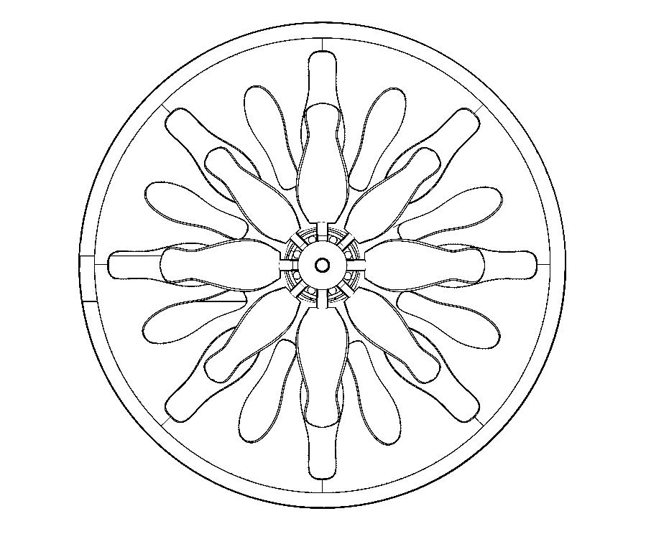
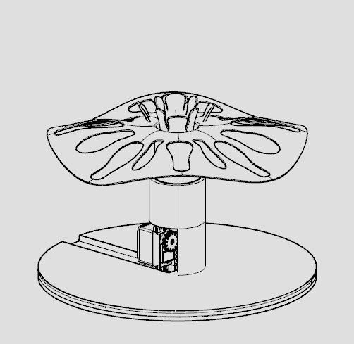
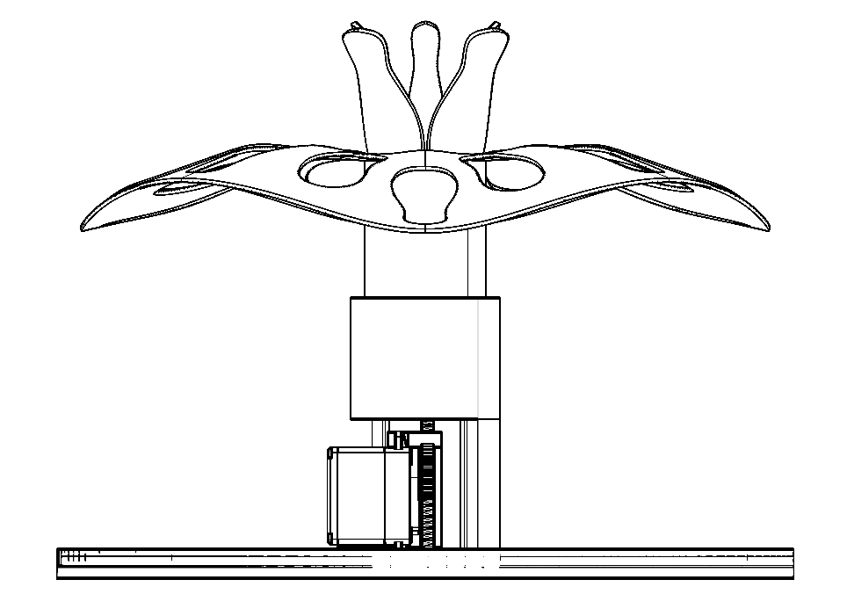
ECE425
3D Floral Design
#16
MIMICKING NATURE
PLAN VIEW
ELEVATION

Slide 18
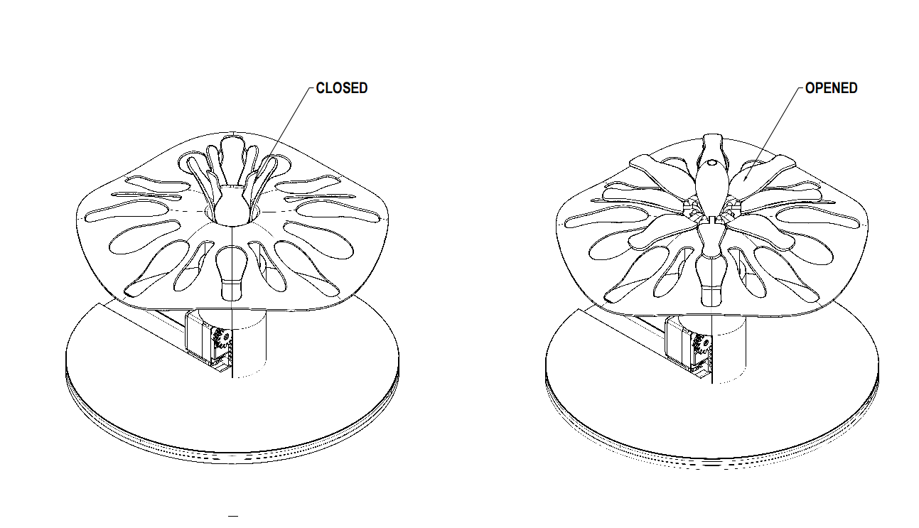
ECE425
3D Floral Design
#17

Slide 19
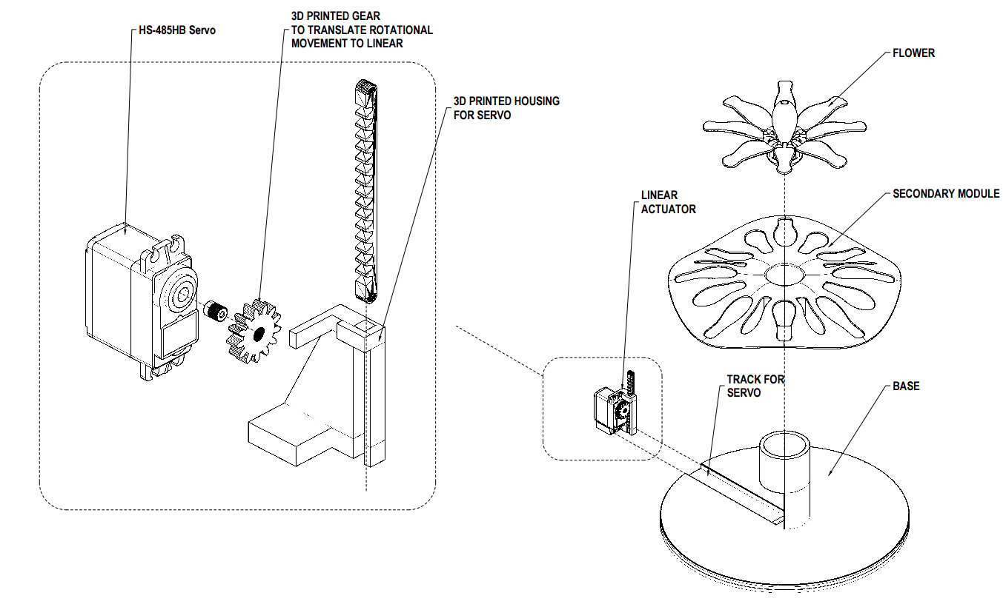
ECE425
3D Floral Design
#18

Slide 20
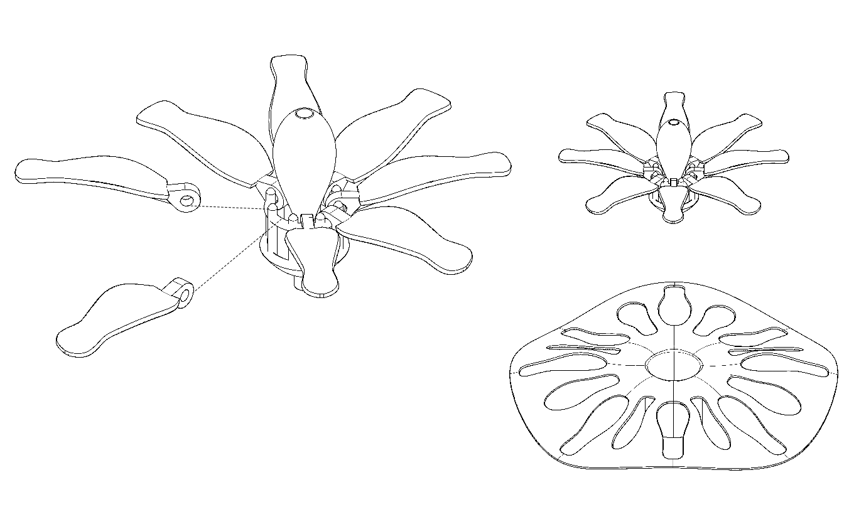
ECE425
3D Floral Design
#19
The central bud designed to prevent petals from collapsing inward
The petals are pivoting around the central ring of the 3d printed flower

Slide 21

ECE425
3D Floral Design
RESULTS
#20

Slide 22

ECE425
3D Floral Design
Manual Mode (button control)
#21

Slide 23
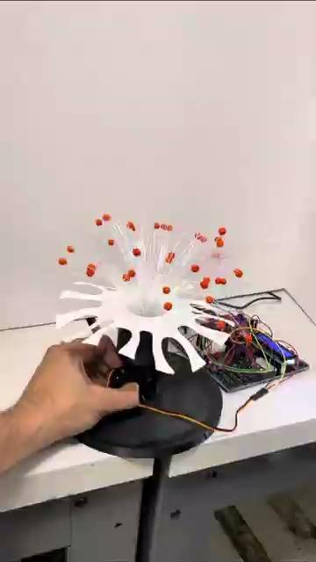
ECE425
3D Floral Design
Automatic Mode (light sensor)
#22

Slide 24
Thank You
Macy Varga & Vedi Vartani
ECE425 Final Project

